Slide 1
SDK Authentication and Secret Management
BRK3342
Josh Gavant, PM, Azure Tools

Slide 2
Agenda
Directory, identity, authentication
Authentication and secrets
Secret zero and other secrets
Authentication and secrets in SDKs and Apps
with demo!
Recap and resources

Slide 3
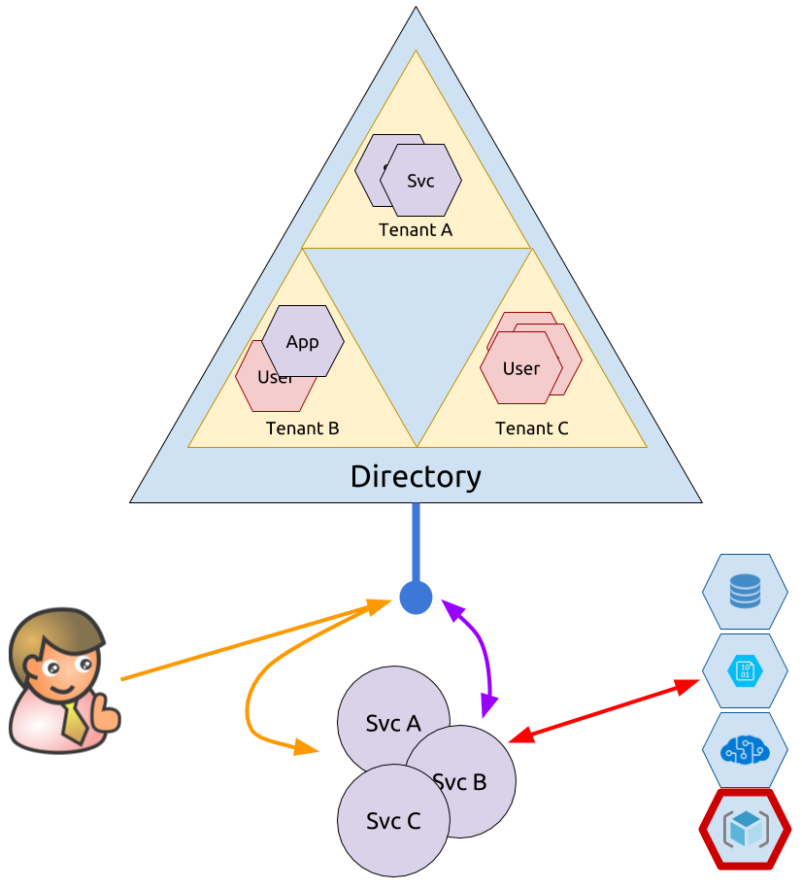
Directory, Identity, Authentication
Active Directory (AAD) is a central directory of principals in Azure.
It also provides protocol endpoints for authentication.
Tokens can represent apps (services) and/or users.
Notes:
* Directory containing many identities and methods of authenticating them.
* Authentication proves identity belongs to bearer.
* Authorization grants/denies rights to identity.
AAD is a central directory for identities in Azure.
AAD is an authentication server.
Services make authorization decisions based on identities in tokens.

Slide 4
Others
Authorization
Resource Manager Role-Based Access Control (RBAC)
Key Vault Access Policies
Dataplane Accounts
Storage
Service Bus
CosmosDB
Cognitive

Slide 5
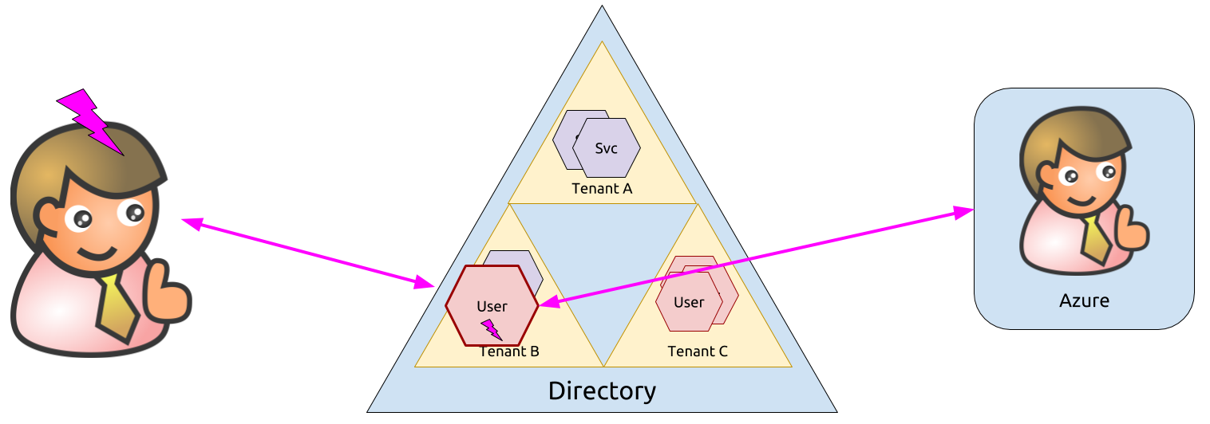
Authentication and Secrets
Authentication proves ownership of an identity. Can this be otherwise proven? Yes, platform can attest to identity – managed identity.
Notes:
With managed identity, the Azure platform attests to the identity of the caller so no secret is needed. It doesn’t work with authorization code flow or dataplane accounts yet though.

Slide 6
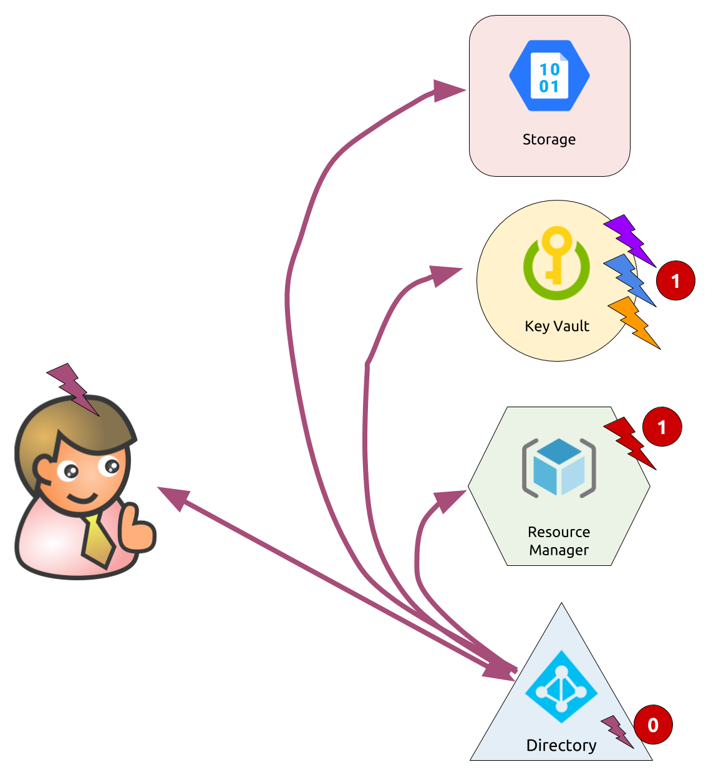
Secret zero and other secrets
Secret Zero is the hardest, then it can get easier.
Options for secret one (and two, three and four…):
Key Vault
Resource Manager
Or OAuth and no secrets ☺
What about client-side apps?
OAuth implicit flow: no secrets, but no app identity
Be careful with keys

Slide 7
Demo: User Profiles App https://github.com/joshgav/UserProfilesApp

Slide 8
Authentication and Secrets in SDKs and Apps
Store secrets in environment
Use `dotnet user-secrets` to store outside of code repo for ASP.NET.
Environment variables and plaintext files work with SDKs but are discouraged.
Get login tokens from CLI
`az account get-access-token`
Helpers in each SDK
Get secrets from Key Vault (or Hashicorp Vault).
Still requires local secret zero.
Use Managed Identity within Azure.
No secret zero needed!
Use OAuth/AAD whenever possible.

Slide 9
Recap
Avoid secret zero by using Managed Identity
Get other secrets from Key Vault (or Resource Manager)
Use OAuth when possible
Resources
Demo: https://github.com/joshgav/UserProfilesApp
Managed Identity: https://docs.microsoft.com/azure/active-directory/managed-identities-azure-resources/
Key Vault: https://docs.microsoft.com/azure/key-vault/
Storage with OAuth: https://docs.microsoft.com/rest/api/storageservices/authenticate-with-azure-active-directory

